Slide 1
Router
React Router | Navigation | URL Parameters | Search Parameters
Notes:
Welcome to our lecture on Routers in react. In this lecture we will go through the react router, navigation, URL parameters, and search parameters. Let’s start the video lecture.

Slide 2
React Router
React Router enables React apps to render different components based on the URL path.
Install it using npm install react-router-dom.
BrowserRouter tracks changes to the browser’s URL.
Routes component holds one or more Route components for navigation.
Notes:
Welcome to this lesson on React Router. React Router allows React apps to render different components based on the URL path, enabling seamless navigation without reloading the page. To use it, install react-router-dom. The Browser Router component tracks URL changes, while Routes holds Route components that define navigation paths in the app.

Slide 3
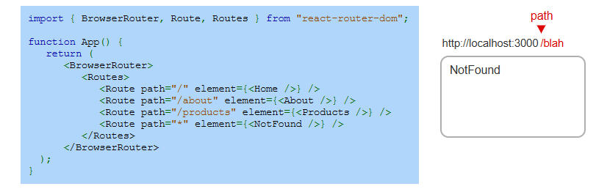
Example
Notes:
Now, let's see an example of how React Router works. In App.js, we wrap our routes inside BrowserRouter. The Routes component contains multiple Route components, each mapping a URL path to a specific component. If a user enters an unknown path, the wildcard route * displays the NotFound component, handling undefined routes effectively.

Slide 4
Navigation
Using <a href="/about"> reloads the entire webpage.
React Router's <Link> component allows navigation without reloading.
Example: <Link to="/about">About</Link> ensures smooth routing.
Notes:
Now that we have defined routes, let's talk about navigation. Using a standard anchor tag for links causes a full page reload. Instead, React Router provides the Link component, which allows smooth navigation without refreshing the page. For example, link tag routing towards about updates the URL and renders the corresponding component efficiently.

Slide 5
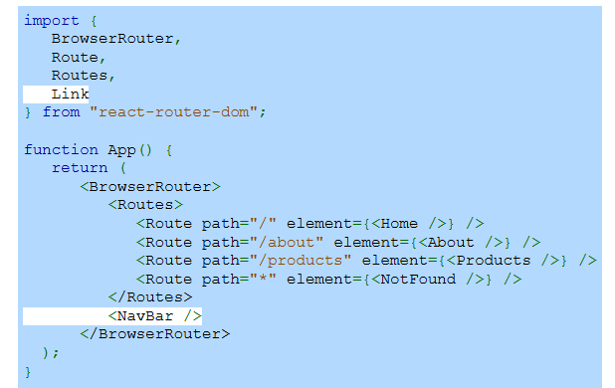
Example
Notes:
Now, let's see how we can integrate navigation into our app. We import the Link component from React Router and add a Nav Bar component inside Browser Router. This ensures that navigation links are always accessible. The Nav Bar will use <Link> components to navigate between routes without reloading the page, providing a smooth user experience.

Slide 6
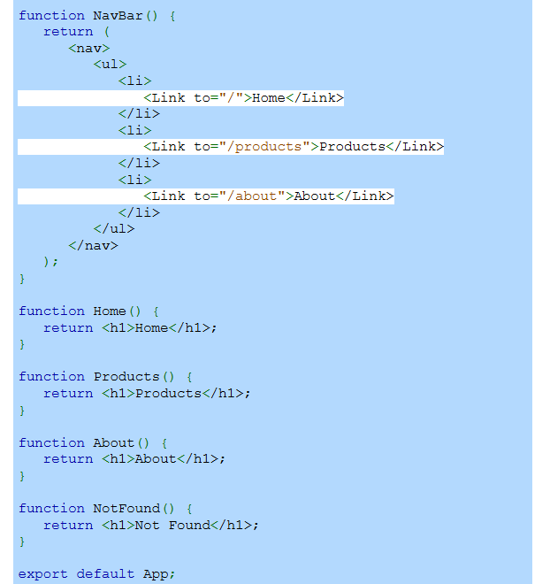
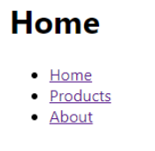
Example (Continue)
Notes:
Continuing from the previous example, we now define the Nav Bar component. It uses link components to create navigation links for Home, Products, and About pages. Instead of anchor tags, link ensures smooth navigation without reloading. We also define basic functional components for each route. The right side shows how the navigation appears in the browser.

Slide 7
URL Parameters
URL parameters allow a React app to extract dynamic values from the URL path.
Define parameters in a Route path using a colon, e.g., path="/products/:productId".
Use the useParams() hook to access parameter values inside a component.
Notes:
Now, let's talk about URL parameters in React Router. These allow us to extract dynamic values from the URL path. We define a parameter in a route using a colon, like back slash products back slash hyphen product Id. Inside the component, we use the use Params hook to access the parameter value. This is useful for displaying specific data, such as product details based on the URL.

Slide 8
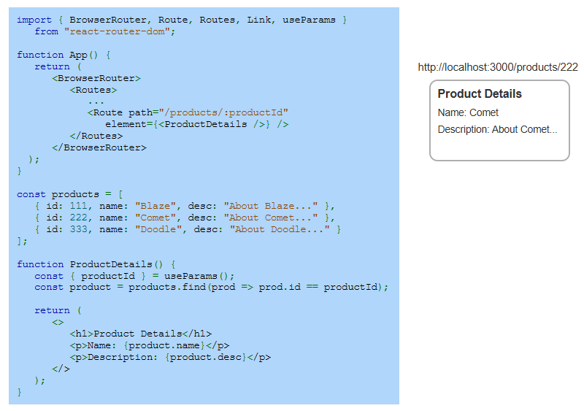
Example
Notes:
Continuing with URL parameters, this example shows how to use them in a React app. We define a route that includes a dynamic parameter for products. Inside the component, we use a hook to extract the parameter and find the matching product from a list. When a user visits a product page, the app dynamically displays the corresponding product details based on the URL.

Slide 9
Search Parameters
Search parameters in a URL query string help filter or limit data (e.g., ?prod=test&limit=10).
Use the useSearchParams() hook to read and modify search parameters in React Router.
setSearchParams() updates the URL, and filter() helps display matching results dynamically.
Notes:
Now, let's explore search parameters in React Router. These parameters allow filtering or limiting data in a URL query string. We use a hook to read and modify search parameters dynamically. Another function updates the URL, while a filter method helps display results based on user input. This makes search and filtering operations more efficient in React applications.

Slide 10
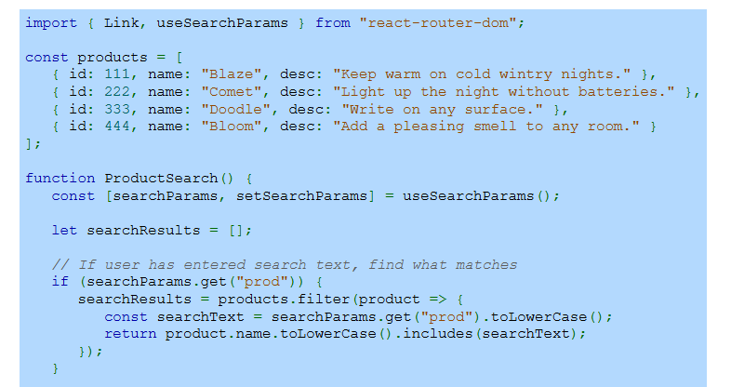
Example
Notes:
Now, let's see an example of search parameters in action. We define a list of products and use a hook to manage search parameters. If a user enters a search term, the app retrieves it from the URL and filters the product list dynamically. This approach allows real-time search updates without needing additional state management, making the app more efficient.

Slide 11
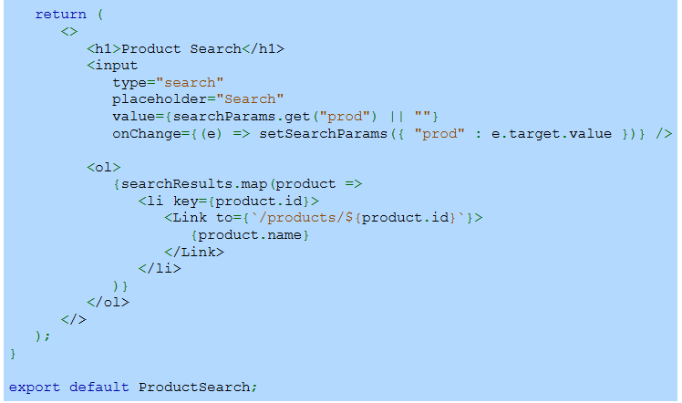
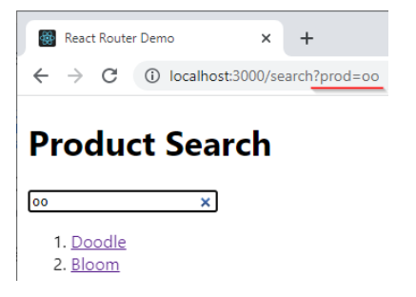
Example (Continue)
Notes:
Continuing from the previous example, we now create a search input field. As the user types, the search term updates the URL dynamically using a function. The product list is then filtered in real-time based on the search query. The filtered results are displayed as clickable links, allowing users to navigate to specific product pages effortlessly.

